Slide 1
Simulating Customer Checkouts with Multithreading in C <//Parallel Computing//>
An Explanation and Walkthrough
Erick W.Pascal,Daniel Darsamo, Scovia Kaiza,Marcos Custanheira

Slide 2
Table of contents
01
02
03
04
<//
//>
Program Overview
Introduction
Screens and Journey
Code Breakdown
05
Conclusion

Slide 3
1. Introduction
<//
//>
Parallelism Concept: Parallelism is the simultaneous execution of multiple tasks or processes .It can significantly improve performance by utilizing multiple CPU cores.
Multithreading: The code uses POSIX threads(p threads for parallel execution .
Each thread represents an independent path of execution within the program ,allowing multiple threads to run concurrently.
Implementation in the code:
Self-checkout and Cashier Lanes: The program simulates customers using self-checkout and cashier lanes in parallel.
Thread creation: For each lane(Self-checkout or cashier ), a new thread is created .Each thread processes its own set of customers independently.
<
<

Slide 4
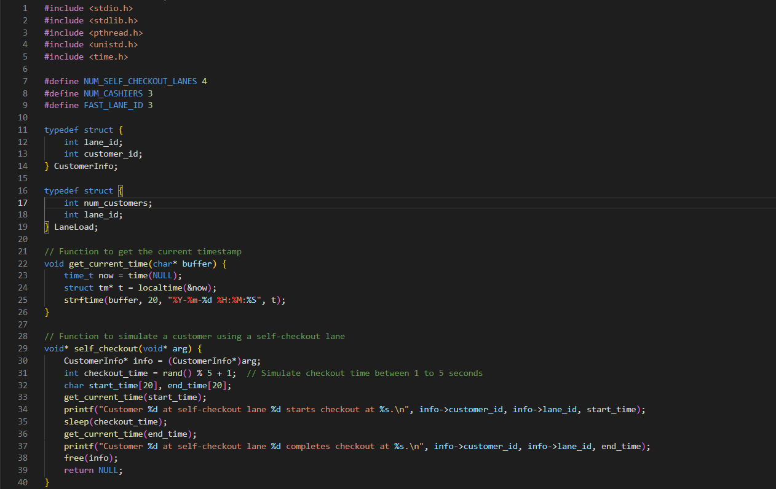
2.1 Program Overview
<//
//>
Define Headers and constants
‘NUM_SELF_CHECKOUT_LANES’: Defines the number of self-checkout lanes(4 in this case).
‘NUM_CASHIERS’ ;Defines the number of cashier lanes(3 in this case).
‘FAST_LANE_ID’ : Represents the ID of a specific fast, though it is not actively used in the current code.
Pthread.h:POSIX thread library for multithreading.
Unistd.h: Provides access to the POSIX operating system API.
<
<

Slide 5
2.2 Program Overview
<//
//>
Define Constants and Data Structure
Data structure:
CustomerInfo:Holds the lane ID and customer ID for each customer.
LaneLoad:Tracks the number of customers in each lane.
<
<

Slide 6
2.3 Program Overview
<//
//>
Helper Function
get_current_time :Gets the current timestamp and formats it as a string.
<
<

Slide 7
2.4Program Overview
<//
//>
Self-checkout Function .
Function
Input: Takes a pointer to ‘LaneData’ structure which contains lane ID and number of customers .
Functionality:
Casts the input to ‘LaneData’ type.
Loops over the number of customers in the lane.
For each customer : Simulates a random checkout between 1 and 5 seconds.
Print a message when the customer starts and completes checkout.
Sleeps for the checkout duration to simulate the process.
Output Returns ‘NULL’
<
<

Slide 8
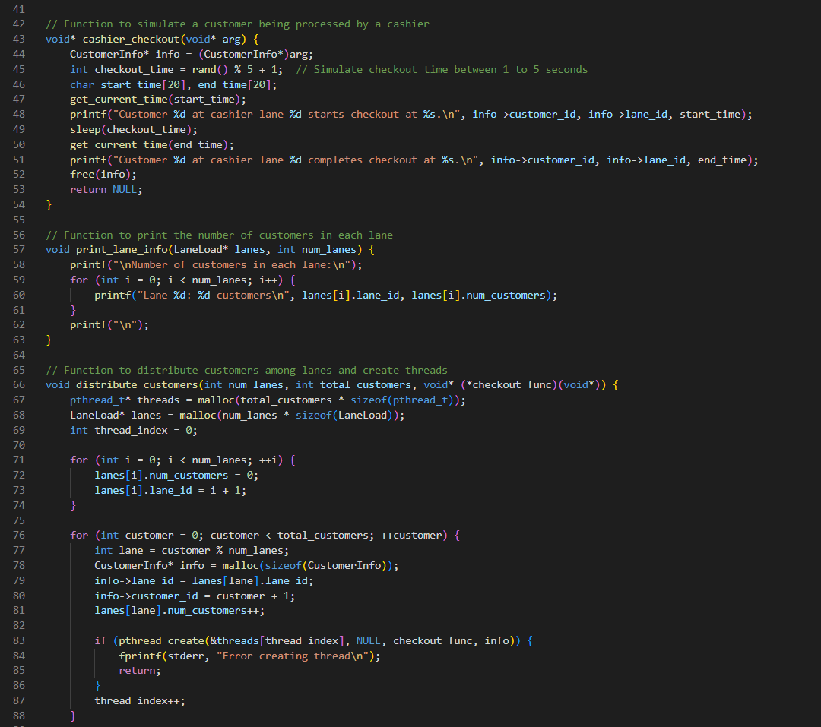
2.5 Program Overview
<//
//>
Cashier Checkout Function :
Input :Similar to ‘self_checkout ‘ , but for cahier lanes.
Functionality:
Identical to ‘self-checkout ‘ ,but for cashier lanes.
Simulates checkout process for customers in cashier lanes.
Sleep for a random duration to simulate checkout.
Output Returns ‘NULL
<
<

Slide 9
2.6 Program Overview
<//
//>
Utility Functions:
‘print_lane_info’:
Prints the number of customers assigned to each lane.
<
<

Slide 10
2.7 Program Overview
<//
//>
distribute_customers :
Distributes customers among lanes and creates threads for each customer.
Ensures each customer is processed in parallel.
Prints the number in each lane after processing.
<
<

Slide 11
2.8 Program Overview
<//
//>
Process cashier_lanes
Input: Array containing the number of customers for each cashier lane.
Functionality:
Similar to’process_self_checkouts’ ,but for cashier lanes.
Creates an array of threads for self-checkout lanes.
For each lane: Allocate memory for ‘customerInfo’
Sets the lane ID and the number of Customers.
Creates a thread to process the lane using ‘Cashier_checkout ‘function.
Waits for all threads to complete using ‘pthread_join’.
Output :Prints a message when all self-checkout lanes have processed their customers.
<
<

Slide 12
2.9 Program Overview
<//
//>
5.Process self-checkouts .
Input: Array containing the number of customers for each self-checkout lane.
Functionality:
Creates an array of threads for self-checkout lanes.
For each lane: Allocate memory for ‘CustomerInfo’
Sets the lane ID and the number of Customers.
Creates a thread to process the lane using ‘self-checkout ‘function.
Waits for all threads to complete using ‘pthread_join’.
Output :Prints a message when all self-checkout lanes have processed their customers.
<
<

Slide 13
2.10 Program Overview
<//
//>
6.Main Function
Functionality:
Seeds the random number generator with the current time to ensure different random sequences each run.
Prompts the user to enter the number of customers for each self-checkout and cahier lane.
Calls ‘process_self_checkouts’to process customers in self-checkout lanes.
Calls ‘process_cashiers’ to process customers in cashier lanes.
Output: Ensure the main program flow and execution of the defined functions.
<
<

Slide 14
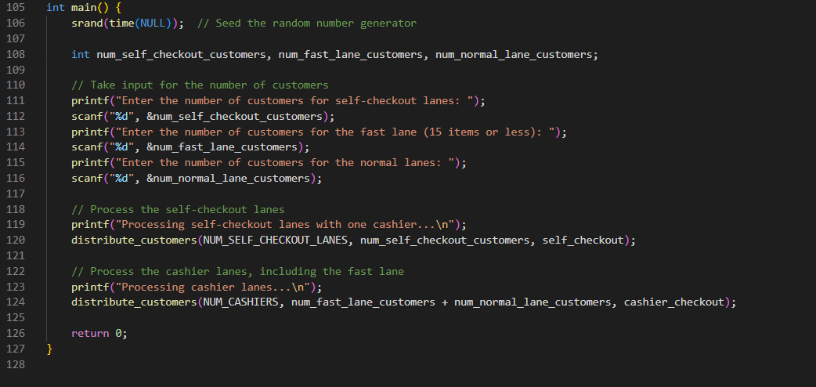
2.10.1Program Overview
<//
//>
6.Main Function:
<
<

Slide 15
3.1 Screens and Journey
<//
//>
1.Input Customer Numbers: The first step is where the user inputs the number of customers for each self checkout and cashier lanes .The user is prompted to enter these values,whuch will be used to simulate the checkout process.
2. Start of Self-checkout Lanes: Here the program begins processing customers at the self-checkout lanes. Each customer is assigned a random checkout time between 1 to 5.
3. Completion of self-checkout Processing of all the customers at the self-checkout lanes .The program ensures all the customers have completed their checkout before proceeding to the next step.
4. Start of cahier lane: The program now starts to process customers at the cashier lanes .Similar to the self-checkout lanes, each customer is assigned a random checkout time.
5. Completion of Cashier lanes: Processing for all customers at the cashier lanes. The program ensures all customers have completed their checkout.
All this is done at the same time both for cashier lane and self-checkout lanes by using multiple threads ‘pthread_create ‘.Each thread simulates the checkout process for a specific lane.
<
<

Slide 16
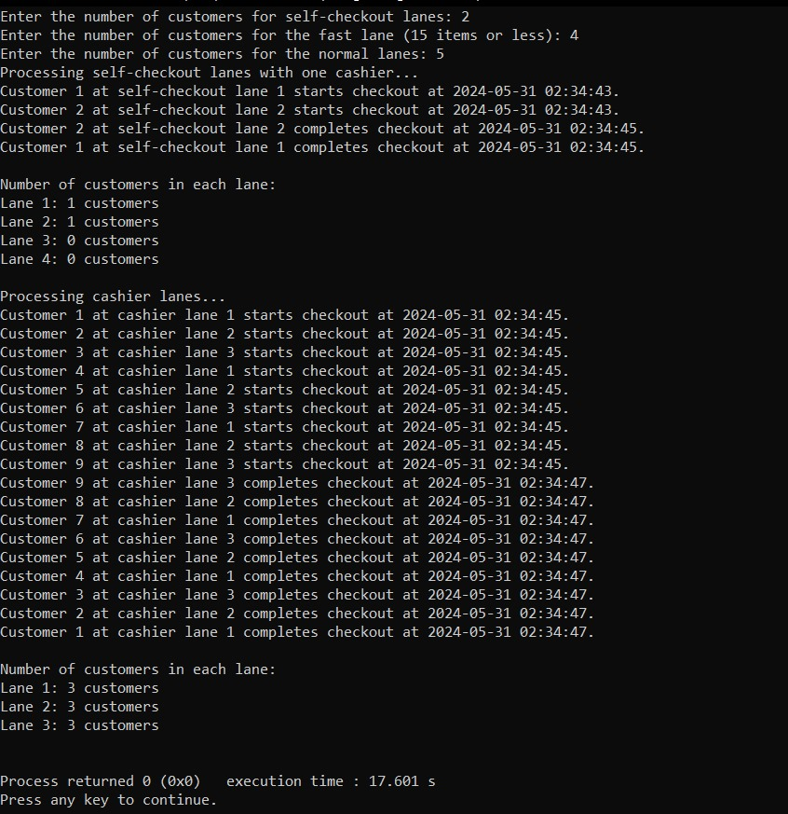
3. 2 Screens and Journey
<//
//>
<
<

Slide 17
3.3 Key Points
<//
//>
The program uses the POSIX thread library (pthread.h) for parallel processing.
Each customer is processed in parallel by creating a separate thread for them.
Mutexes are used to ensure correct synchronization within each lane.
The program prints the start and end times of the checkout process for each customer to demonstrate parallelism.
<
<

Slide 18
4. Conclusion
<//
//>
Importance of Multithreading:
Simultaneous Task Handling: Multithreading allows the program to handle multiple tasks at the same time ,which is crucial for simulating a busy environment like a supermarket.
Parallel Processing: By using threads ,the program processes multiple customers simultaneously reducing the overall wait times.
Scalability: The program can easily scale by increasing the number of cashier lanes or self-checkout stations ,demonstrating the principle of parallel computing.
Thread creation: The program creates multiple threads using ‘pthread_create’.Each thread simulates the checkout process for a specific lane.
Each thread runs concurrently ,allowing multiple customer checkouts to be processed at the same time.
Each thread independently processes its assigned customers.(sleeping for a random amount of time to represent the time taken by each customer).
The program uses ‘pthread_join’to wait for all threads to complete before proceeding .This ensures that all customers are processed before the program terminates.
<
<

